Slide 1
24
7
30
Date
Probability
EQ – What have we learned about Probability so far this year?

Slide 2
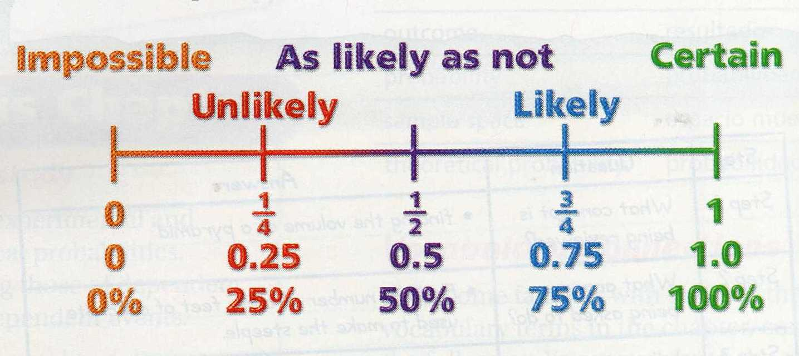
Probability: is the likelihood that an event will occur.
  Probability can be written as a fraction or decimal.
_______________
_______________
_______________

Slide 3
Probability is always between 0 and 1.
Probability = 0 means that the event will NEVER happen.
  Example: The probability that the Perth Wildcats will win the AFL Grand Final this year.
Probability = 1 means the event will ALWAYS happen.
  Example: The probability that Christmas will be on December 25th next year.

Slide 4
Event: A set of one or more outcomes
  Example: Getting a heads when you toss the coin is the event
Compliment of an Event: The outcomes that are not the event
  Example: Probability of rolling a 4 = 1/6. Not rolling a 4 = 5/6.
Experiment: an activity involving chance, such as rolling a cube
  Tossing a coin is the experiment
Trial: Each repetition or observation of an experiment
  Each time you toss the coin is a trial

Slide 5
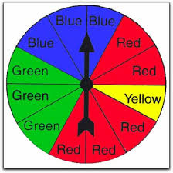
Outcome: A possible result of an event.
  Example: An outcome for flipping a coin is H
  Example: The list of all the outcomes for flipping a coin is {H, T}
Sample space: A list of all the possible outcomes.
  Example: The sample space for spinning the spinner below is:
  {B, B, B, R, R, R, R, R, Y, G, G, G}.

Slide 6
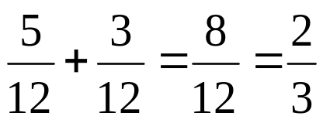
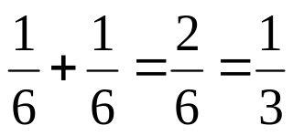
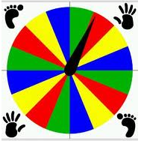
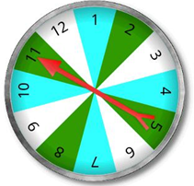
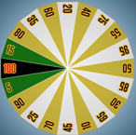
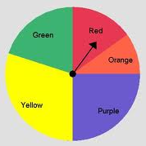
Calculating OR Probabilities: by adding the probabilities.
  Example: P (Red or Green) in the spinner
  Example: When rolling a die: P(3 or 4)
Uniform Probability: an event where all the outcomes are equally likely.
  Which spinners have uniform probability?
X
X

Slide 7

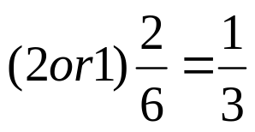
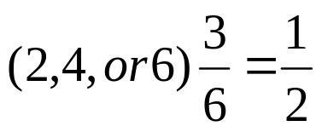
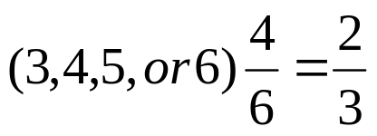
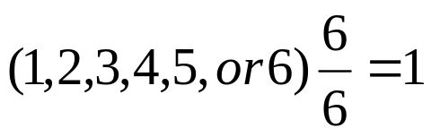
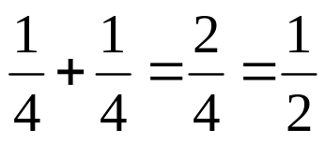
Calculating Probabilities
Rolling a 0 on a number cube
Rolling a number less than 3 on a number cube
Rolling an even number on a number cube
Rolling a number greater than 2 on a number cube
Rolling a number less than 7 on a number cube
Spinning red or green on a spinner that has 4 sections (1 red, 1green, 1 blue, 1 yellow)

Slide 8
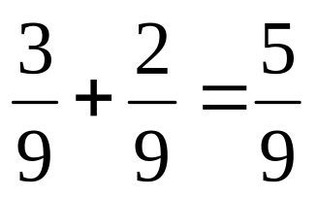
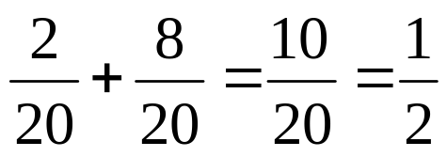
Calculating Probabilities Contd
Drawing a black marble or a red marble from a bag that contains 4 white, 3 black, and 2 red marbles.
Choosing either a number less than 3 or a number greater than 12 from a set of cards numbered 1 – 20.

Slide 9
Independent Practice

Slide 10
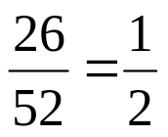
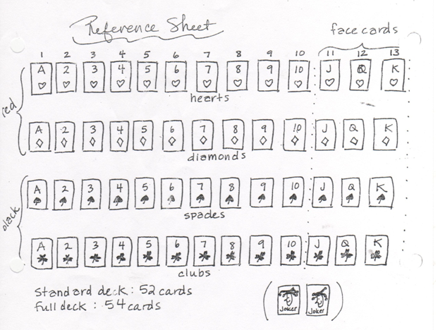

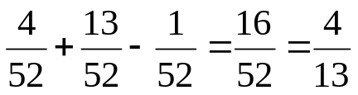
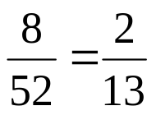

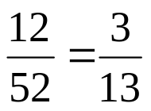
Independent Practice
Using a standard Deck of Cards, calculate the following probabilities
P(red)
P(7 of hearts)
**P(7 or a heart)
P(7 or 8)
P(a black heart)
P(face card)

Slide 11
Experimental vs Theoretical Probability

Slide 12
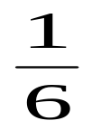
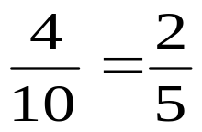
Theoretical Probability: the probability of what should happen. It’s based on a rule:
  Example: Rolling a dice and getting a 3 =
Experimental Probability: is based on an experiment; what actually happened.
  Example: Alexis rolls a strike in 4 out of 10 games. The experimental probability that she will roll a strike in the first frame of the next game is:

Slide 13
Theoretical vs Experimental Probability
Experimental
Fill in table:
What is the experimental probability of getting a red?
What is the experimental probability of getting a blue?
What is the experimental probability of getting a yellow?
Theoretical
Fill in Table:
What is the theoretical probability of getting a red?
What is the theoretical probability of getting blue?
What is the theoretical probability of getting a yellow?
Block Color | Frequency
Red
Blue
Yellow
Block Color | Frequency
Red
Blue
Yellow

Slide 14
Theoretical and experimental probability of an event may or may not be the same.
The more trials you perform, the closer you will get to the theoretical probability.

Slide 15
Try the Following

Slide 16
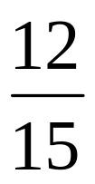
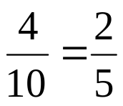
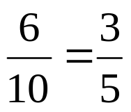


Calculate and state whether they are experimental or theoretical probabilities.
During football practice, Sam made 12 out of 15 field goals. What is the probability he will make the field goal on the next attempt?
Andy has 10 marbles in a bag. 6 are white and 4 are blue. Find the probability as a fraction, decimal, and percent of each of the following:
  P(blue marble) b. P(white marble)
Experimental
Theoretical

Slide 17

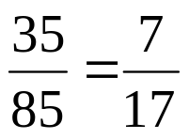
If there are 12 boys and 13 girls in a class, what is the probability that a girl will be picked to write on the board?
Ms. Beauchamp’s student have taken out 85 books from the library. 35 of them were fiction. What is the probability that the next book checked out will be a fiction book?
Theoretical
Experimental

Slide 18


What is the probability of getting a tail when flipping a coin?
Emma made 9 out of 15 foul shots during the first 3 quarters of her basketball game. What is the probability that the next time she takes a foul shot she will make it?
Theoretical
Experimental

Slide 19

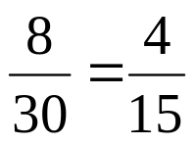
What is the probability of rolling a 4 on a die?
There are 8 black chips in a bag of 30 chips. What is the probability of picking a black chip from the bag?
Theoretical
Theoretical

Slide 20

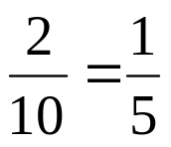
Christina scored an A on 7 out of 10 tests. What is the probability she will score an A on her next test?
There are 2 small, 5 medium, and 3 large dogs in a yard. What is the probability that the first dog to come in the door is small?
Experimental
Theoretical

Slide 21
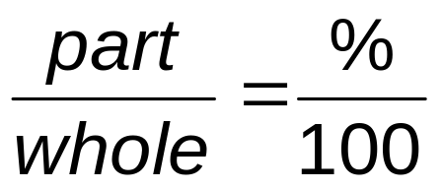
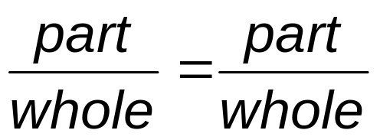
Predicting Probabilities

Slide 22
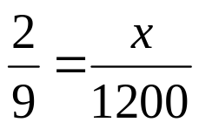
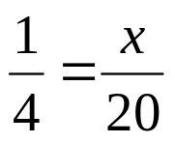
Making Predictions: Remember for predications we use proportions.
A potato chip factory rejected 2 out of 9 potatoes in an experiment. If there is a batch of 1200 potatoes going through the machine, how many potatoes are likely to be rejected?
Based on Colin’s baseball statistics, the probability that he will pitch a curveball is 1/4. If Colin throws 20 pitches, how many pitches most likely will be curveballs?
267 potatoes
5 curveballs

Slide 23
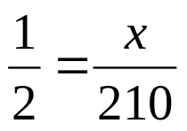
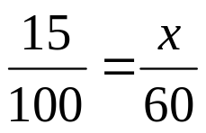
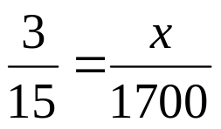
If John flips a coin 210 times about how many time should he expect the coin to land on heads?
If the historical probability that it will rain in a two month period is 15%, how many days out of 60 could you expect it to rain?
If 3 out of every 15 memory cards are defective, how many could you expect to be defective if 1700 were produced in one day?
105 times
9 days
340 memory cards

